Slide 1

Low-Cost Optical Communications System
By: Team 3 (Jarrod Siglin, Cameron Martinez, Sean Huber, Matthew Simms, Dylan Koch, Dominic Steiner)

Slide 2
Why Optical Communications?
Near infra-red frequencies (750-1600 nm)
Demand for RF spectrum is outstripping supply
New frequency bands needed
Benefits:
High data transmission rate (over 100 Gbps)
Less power consumption than radio, microwave and other similar technologies
Small/light physical design
Considered emerging technology by NASA and other aerospace companies
More research will lead to decrease in cost and application difficulty
Notes:
Optical Communications is a relatively new technology that allows for rapid, high-bandwidth wireless transmission of data across nearly any distance.
This technology can transfer data at rates much faster than radio, microwave, or other contemporary technologies (over 100Gbps), all the while using less power, a smaller payload size, and an overall smaller/lighter physical design.
Researching and developing Optical Communication Systems will benefit multiple industries, especially the Aerospace Industry, as transmissions across the solar system would require less power and time to receive the same amount of information compared to a different transmission style.
Proliferation of this technology would lead to a decrease in cost and difficulty in application; can have positive impacts for other industries that already require fast, wireless transfer of data.

Slide 3
Design Considerations
Cost
System shall cost under $2000 USD.
System shall use commercial-off-the-shelf (COTS) components.
Hardware
System shall use a 1550 nm wavelength laser diode (NIR-C class).
System shall be remotely operated via a SSH server/client connection.
System shall operate across free space.
Software
System shall use the OpenCV libraries, for encoding and decoding the video feed.
System shall use Python3 for all software implementation.
System shall use On-Off Keying (OOK) for modulation.
Notes:
Design Considerations o Assumptions, dependencies o General Constraints o Industrial Standards Followed (if there are any) o Safety constraints and considerations o Other

Slide 4
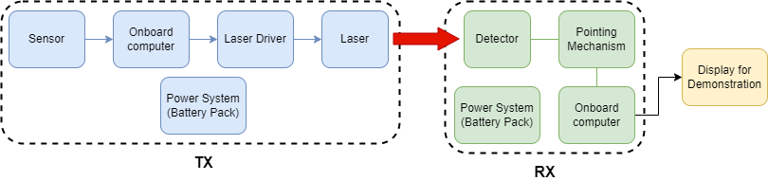
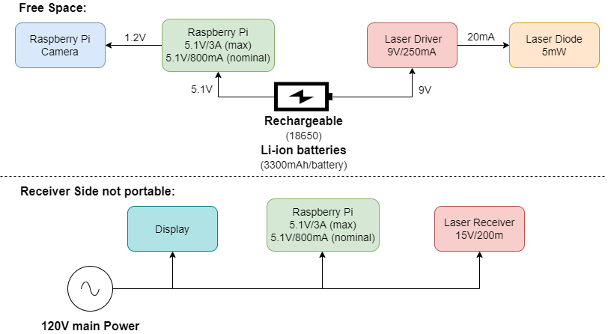
System Architecture and Design
Free space communication
1552nm laser diode
Performed using O.O.K to communicate the UART standard.
Two subsystems: TX and RX
TX – Modulate laser via diode driver using video data.
RX – Demodulate received data into video display and save it remotely.
Software will be handled on the host RPI for both TX and RX, using python3 and RPI specific GPIO APIs.

Slide 5
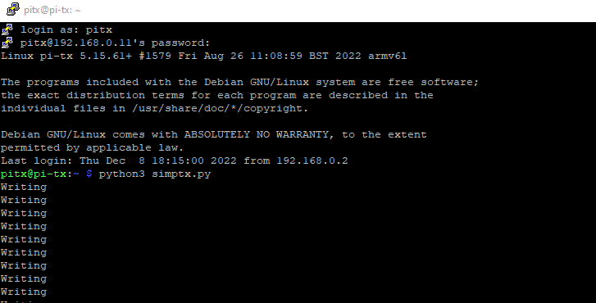
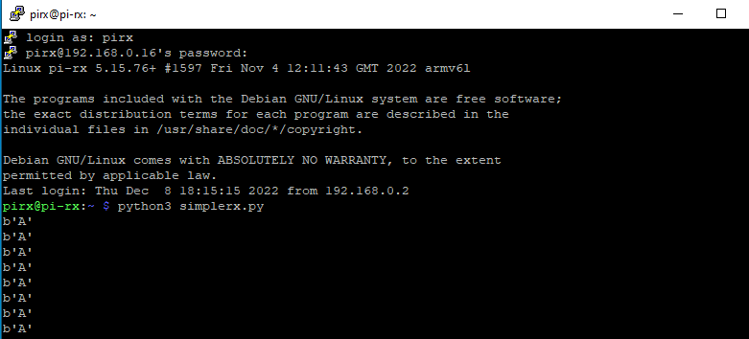
Software
Goals:
Bring in Pi camera video feed, break into individual frames, encode using OpenCV.
Send the encoded byte data through the included PL011 UART GPIO pin.
Receive and decode the byte data to reformat into a video feed.
Display the feed on a physical display and a web page using Flask.
Be able to access and control the system from a local network using a Secure Shell
Pi-Tx Sending the character 'A' through GPIO pin 14
Pi-Rx Receiving the character 'A' through GPIO pin 15

Slide 6
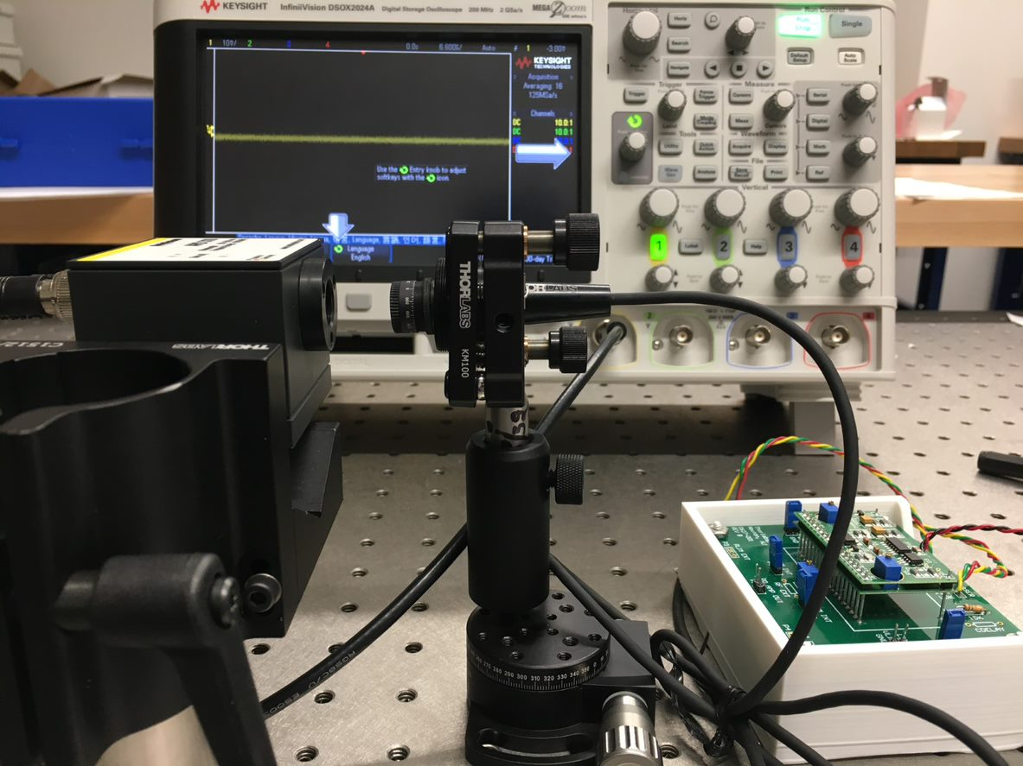
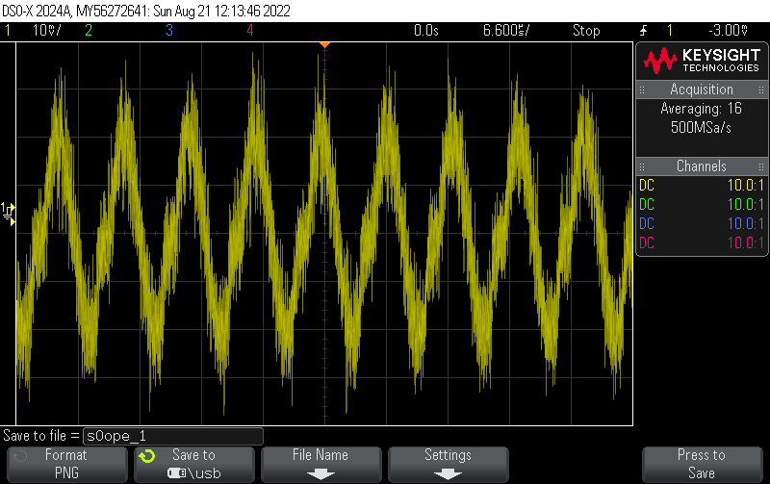
Setbacks
Waiting for previous sensor to be delivered
Security of workspace
Unable to receive signal
- Driver issues
- Diode failed
Setup with previous detector showing no signal.
Expected result
Notes:
Remember to shout-out Ian for the time off.

Slide 7
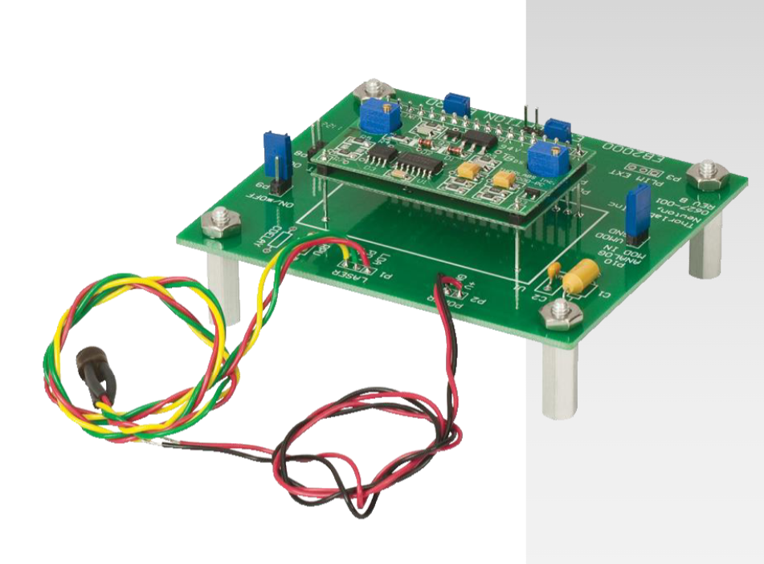
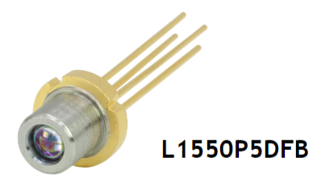
Solutions
Purchased new sensor (PDA20C2 Fixed-Gain Detector).
Order another laser driver and diode.
Better maintain delicate equipment.
Store away equipment when not in use.

Slide 8
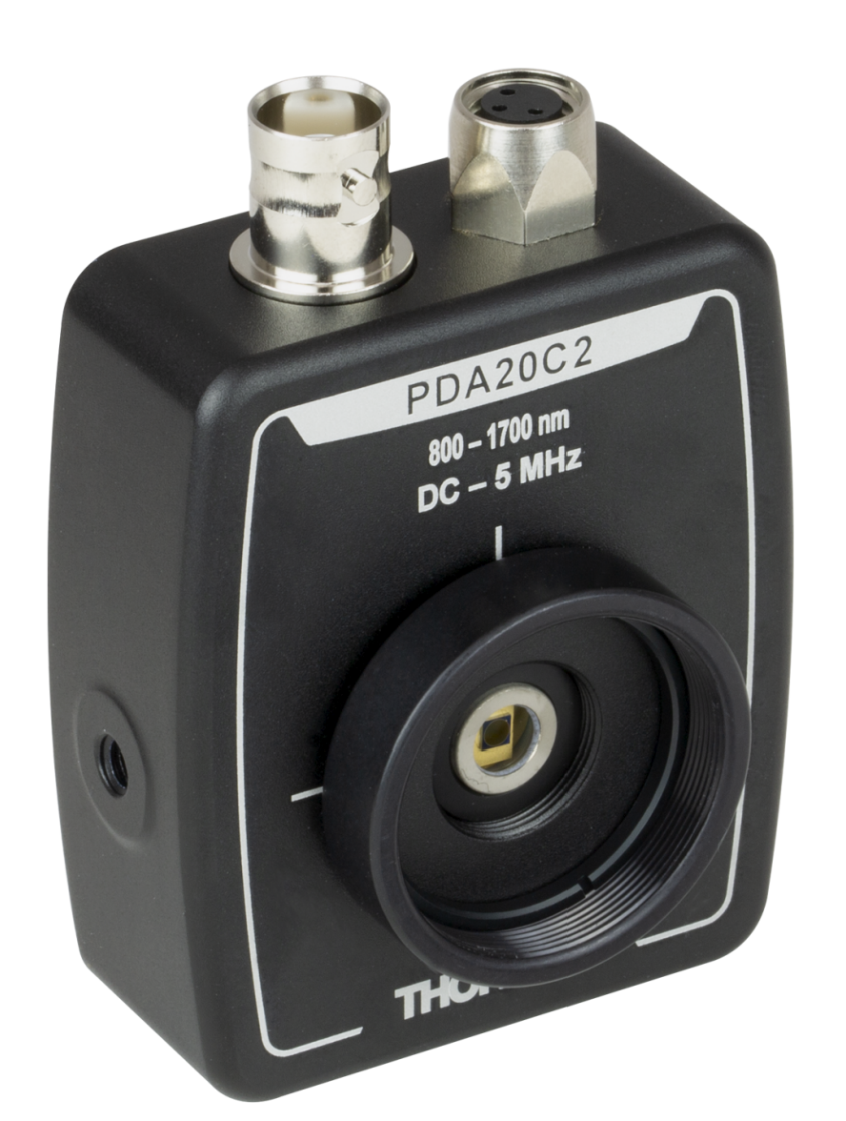
Photodetector
New Sensor
PDA20C2 – ThorLabs
800-1700 nm
Fixed gain
Output: 3.5V Maximum
Detector diameter: 2.0 mm
Much cheaper

Slide 9
Past Project Timeline
Sprint 1:
Constructed table layout.
Able to transmit 1.35 mW, with 1552 nm laser diode.
Observed diffusion of laser over free space
Researched signal amplification options (lenses)
Planned Sprint 2:
Use lenses to increase range
Consistently read signal from receiver on an oscilloscope.
Begin coding of Raspberry Pi for amplitude modulation.

Slide 10
Past Project Timeline
Actual Sprint 2:
Began coding Raspberry Pi's
Soldered 1 kΩ resistor for increased power: 1.35 mW to 4 mW
Troubles with current sensor (APD310)
Researched new receiver and returned old one
Planned Sprint 3:
Learn to operate new sensor
Finalize modulation with Raspberry Pi's
Use new lenses to increase transmission range
Integrate camera to transmitter and a visual display to receiver.
Design and create power sub-systems for transmitter.

Slide 11
Project Timeline
Actual Sprint 3:
Learn to operate new sensor
Modulation with Raspberry Pi's
Used new lenses to increase transmission range
Planned Future Sprints:
Complete modulation with Raspberry Pi's
Integrate camera to transmitter and a visual display to receiver.
Practice wire management and safety.
Begin working on receiver tracking
Design and create power sub-systems for system.

Slide 12
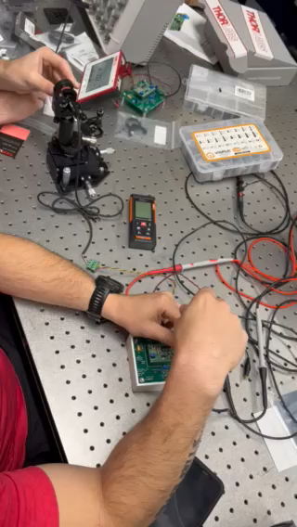
Sprint 2: Increased received power from 1.3 mW to almost 4 mW.

Slide 13
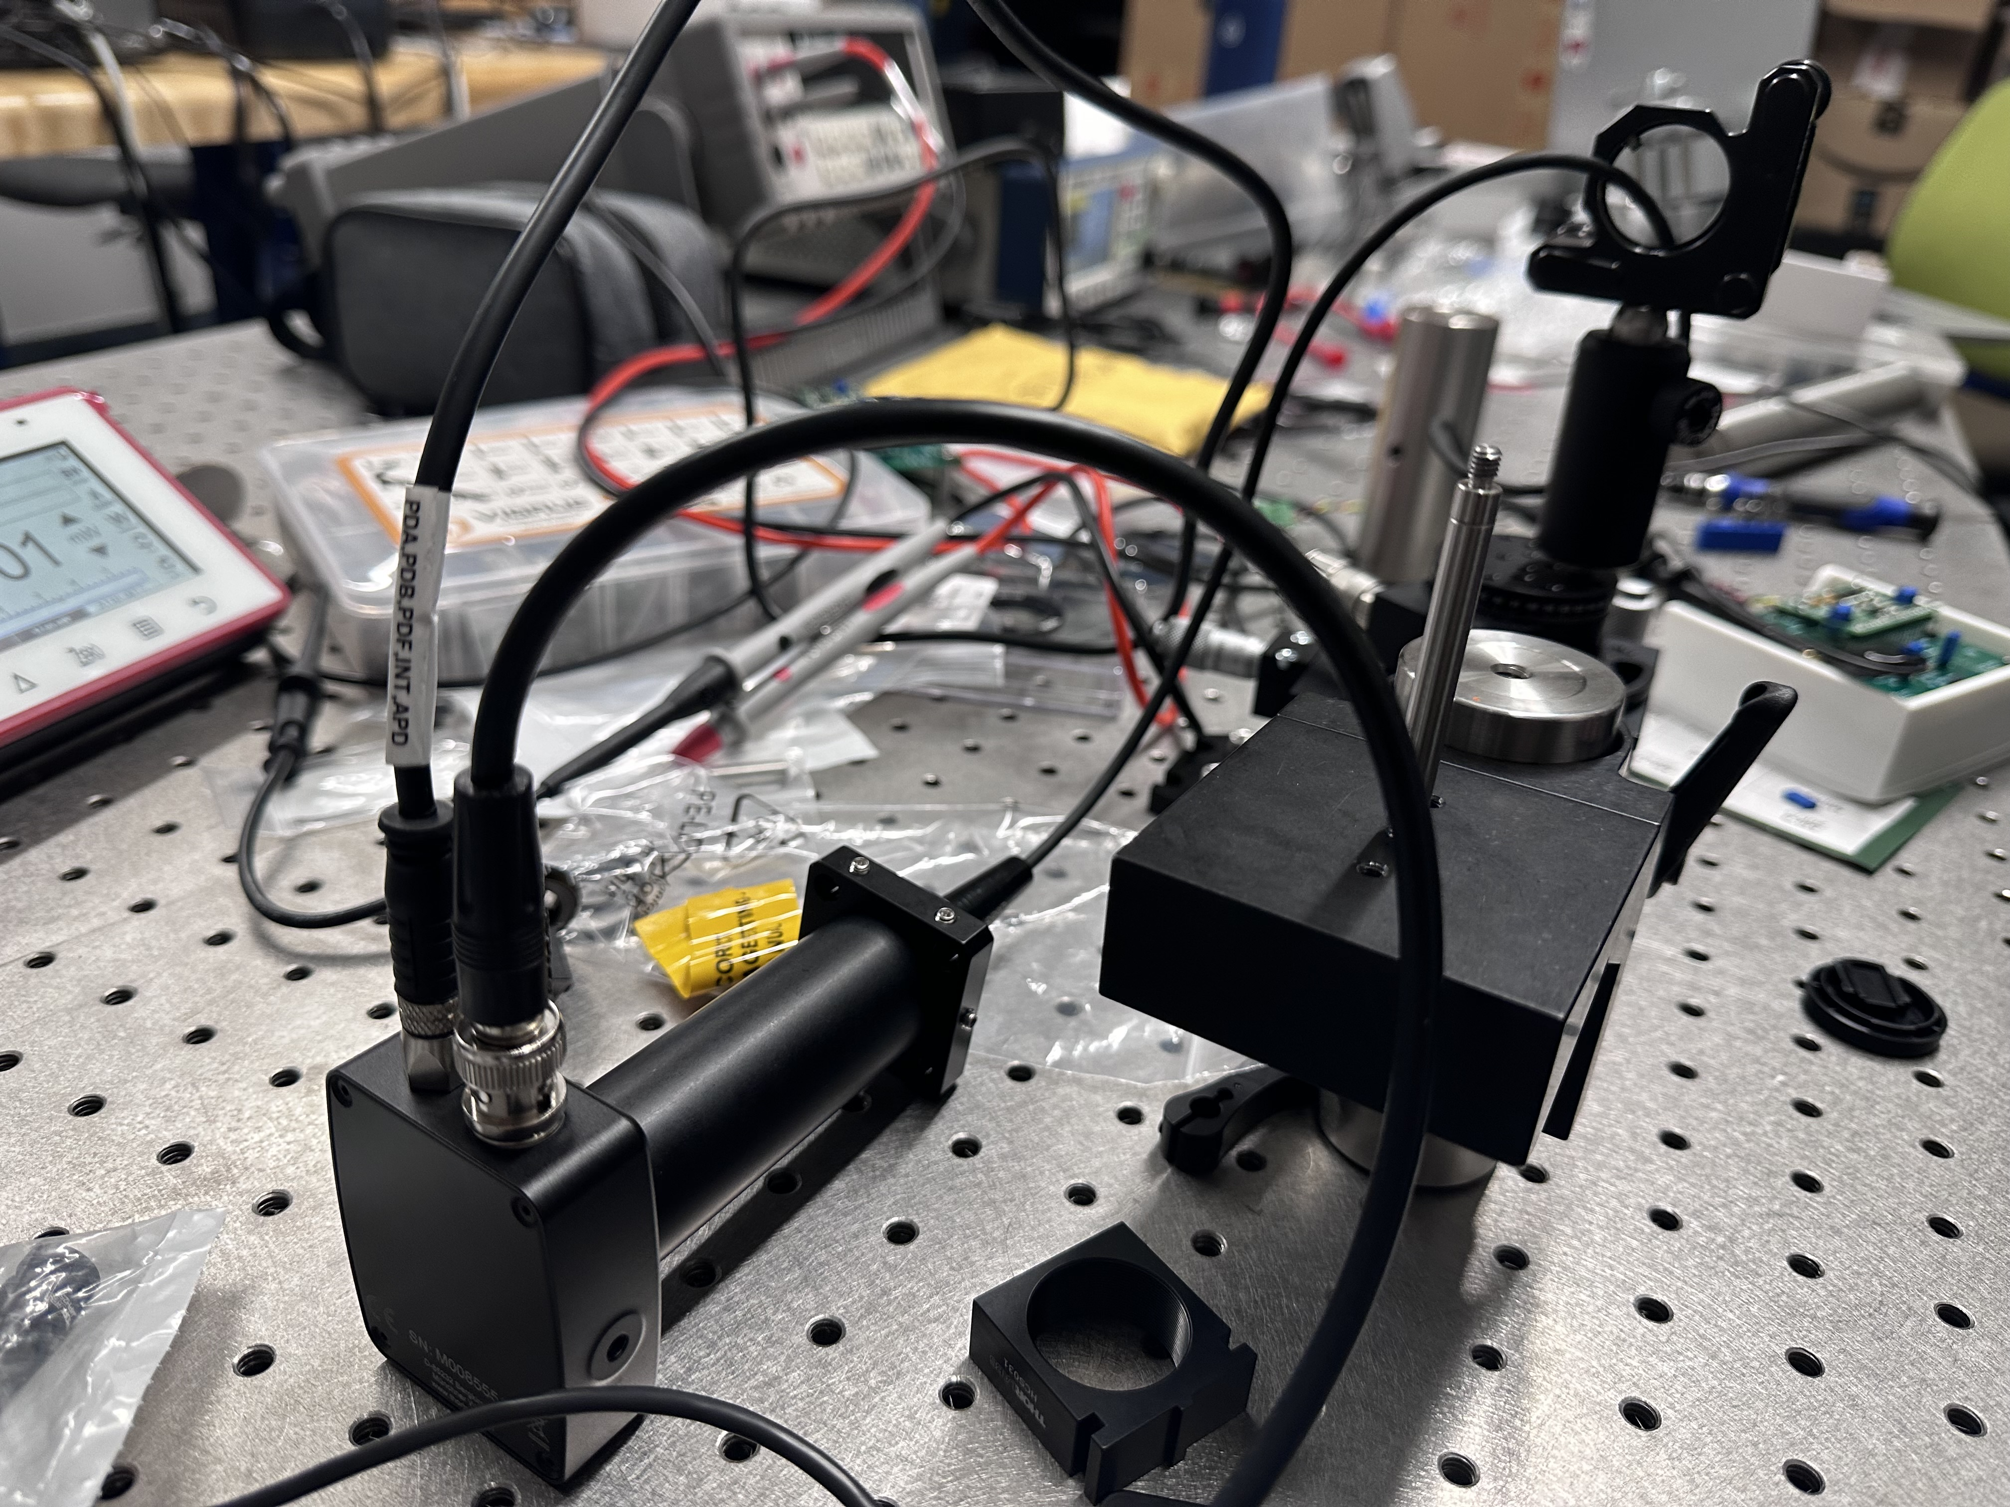
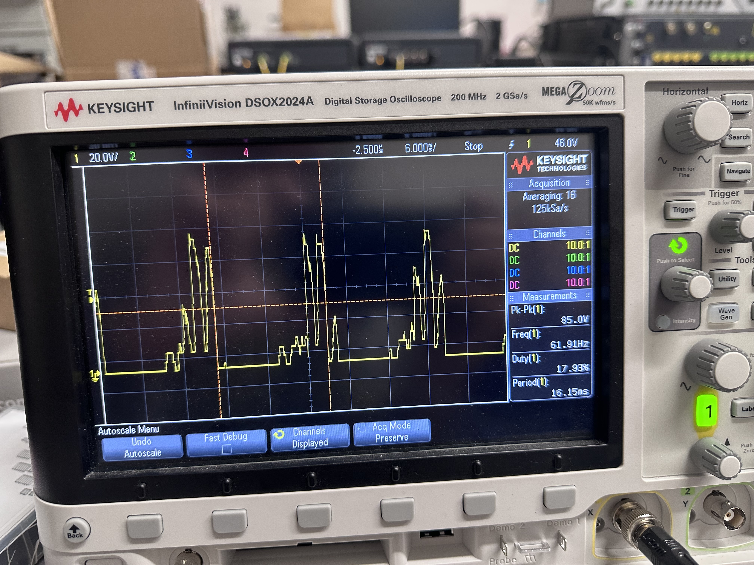
Sprint 3: Current test Optical System layout (left) and oscilloscope test modulation signal (right).

Slide 14
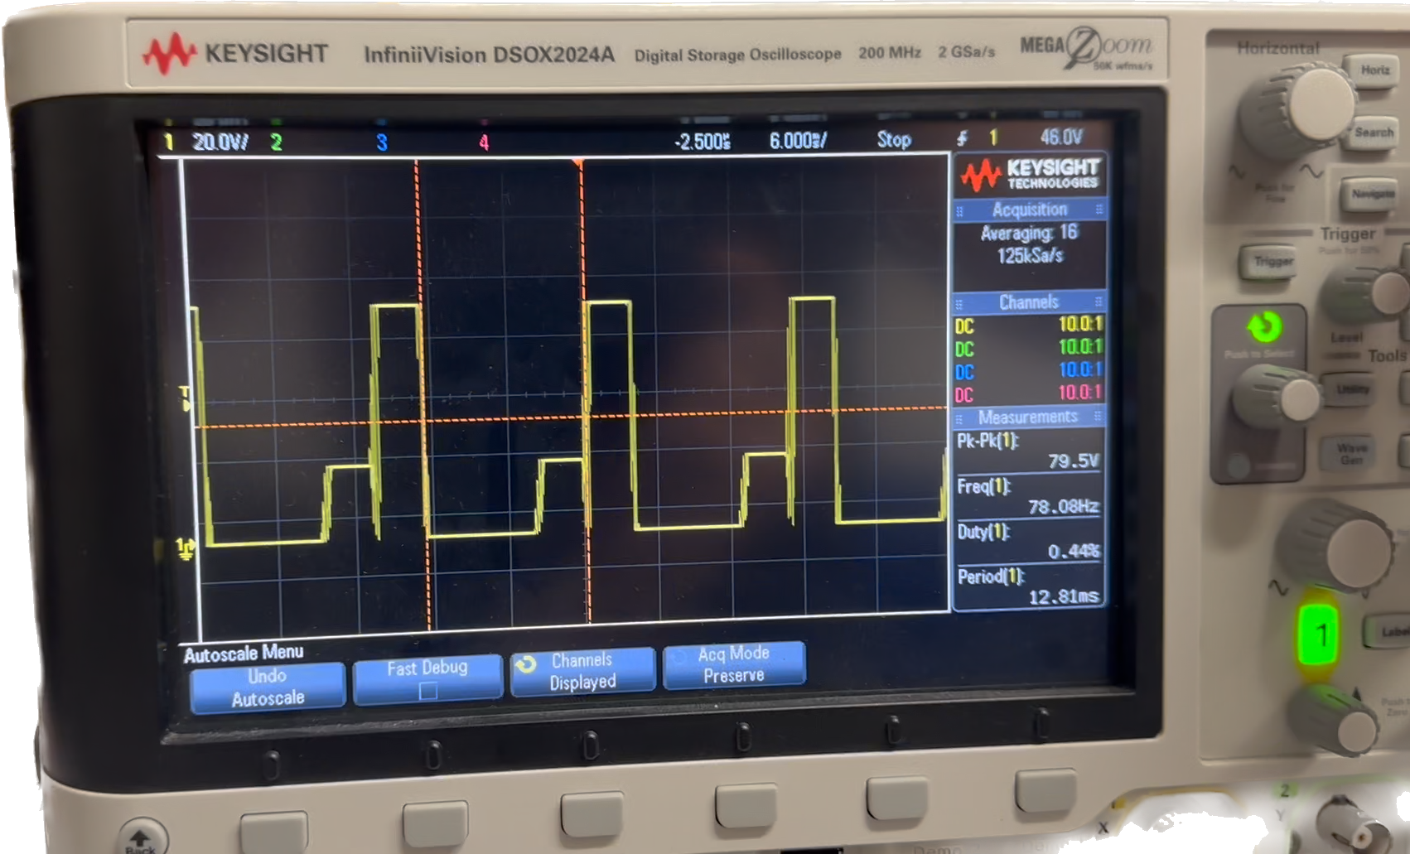
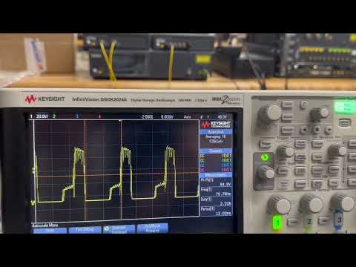
Sprint 3: Test transmission of modulated signal.
Test Transmission Signal Demo

Slide 15
Questions?
Ask away!

